Slide 1
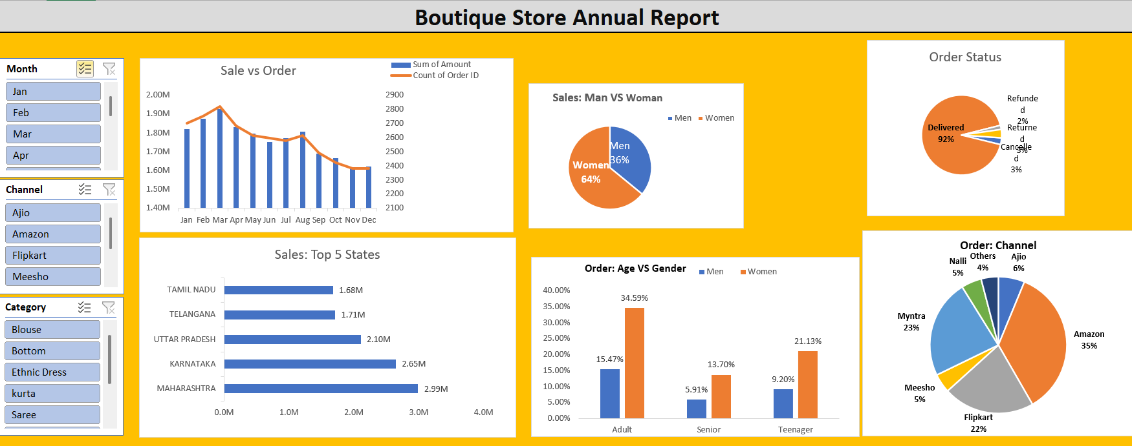
Boutique Store Annual Sales Report 2022
Key Insights
- Women contributed 64% of total sales.
- Maharashtra generated the highest revenue at 2.99M.
- Amazon was the leading sales channel at 35%.
Dashboard Overview
- Maharashtra generated the highest revenue at 2.99M.
- Amazon was the leading sales channel, contributing significantly to the total revenue.
Suggestion
Expand the product range targeting female customers to capitalize on their significant contribution to sales.
Increase focus on the Maharashtra market with localized marketing and promotions to leverage its revenue flow.
Optimize sales strategies on Amazon to increase visibility and conversion rates.

